Slide 1
Insurance in non legislated provinces
From Massage Therapy Perspective

Slide 2
Speakers:
Lori Green, Executive Director of the Massage Therapists’ Association of Saskatchewan (non-regulated) and Vice-Chair of the Canadian Massage Therapy Alliance
Brenda Locke, Executive Director of the Massage Therapists’ Association of British Columbia (regulated) and Treasurer of the Canadian Massage Therapy Alliance

Slide 3
Canadian Massage Therapy Alliance? Who is that?
The CMTA is a nationwide alliance composed of provincial professional associations to provide a forum for collaboration to advance massage therapy as a health care profession in Canada.
The CMTA works co-cooperatively to promote massage therapy as a component of the Canadian health care system, and to ensure the highest standards in providing massage therapy to the public.
Notes:
Promoting the science, art and philosophy of massage therapy nationwide;
Representing the membership before governmental and regulatory bodies concerned with massage therapy;
Fostering and encouraging professional growth and continuing education among its members;
Promoting high standards of practice in Canada;
Promoting high standards of education for students of massage therapy;
Providing a method of communication between members in order to share experience and information, particularly in regard to political and educational opportunities;
Promoting knowledge transfer of research and evidenced informed practice among its’ membership;
Assisting non-regulated provinces become regulated
Presenting a National Voice for Registered Massage Therapy in Canada.

Slide 4
Criteria to be a member of the CMTA?
A not-for-profit organization, incorporated in a Canadian jurisdiction, that represents massage therapists in Canadian jurisdictions where the profession is regulated, or that has as its primary business, the promotion of high standards of excellence in the profession of massage therapy, and meets a minimum competency equivalence ratified by the Board of Directors, as determined from time to time, may become a Full Member entitled to all the privileges of membership.

Slide 5
National Healthcare Groups (Alliance)
Provincial Health groups that work together in area of National Best Practice and with Transparency.
National Standards of Education and Practice
Quality Assurance
Research Informed Practice
Evidence informed Knowledge Transfer
Notes:
National standards: everyone abides under the same regulatory practice e.g. Saskatchewan
Quality Assurance: What is considered life long education - focus on ‘in scope”
Research informed practice/Evidence based: e.g. where is the evidence in modality’s used

Slide 6
Aspirations of the non regulated??
National examinations procured through a third party
Accreditation of Educational Institutions throughout the country

Slide 7
What is health care?
medical Definition of health care. : the maintaining and restoration of health by the treatment and prevention of disease especially by trained and licensed professionals (as in medicine, dentistry, clinical psychology, and public health)
Merriman- Webster Dictionary

Slide 8
Appropriate Care
Appropriateness of Care. Appropriate care is defined as "the right care, provided by the right providers, to the right patient, in the right place, at the right time, resulting in optimal care." (Canadian Medical Association)

Slide 9
Aromatherapy
Spa Services
Watsu
Drumming Circles
Angel Therapy
Body Talk
Crystal Therapy
Tai Chi
Yoga
Brain Gym
Aquatic Therapy
Drumming Circles
Reflexology

Slide 10
Defined? Undefined?
Chiropractors
Physio Therapists
Dental
Medical
Naturopaths
Podiatrists
Pedorthics
Acupuncture
Massage Therapy
Athletic Therapist
Naturopathic Doctors
Traditional Chinese Medicine

Slide 11
Risk of Harm: Review of Medical Literature as applied by individuals ranging from the un- or undertrained to those displaying poor professional judgement and clinical error.
there is evidence of significant threat to public safety when massage therapy, as applied in contexts identical to what one would find in Canada - chair massage
sports-related intervention,
spa services,
pain interventions
treatment of the elderly
treatment of children
assessment
Notes:
The Canadian massage therapy context (specifically, the unregulated provinces) exactly reflects the potential for risk of harm , from minor to life-threatening adverse events attributed to massage therapy in the published medical literature in international journals including cases from North America, Europe and Asia. The review of the literature shows that there is evidence of significant threat to public safety when massage therapy, as applied in contexts identical to what one would find in Canada - chair massage, sports-related intervention, spa services, pain interventions, treatment of the elderly, treatment of children - and as applied by individuals ranging from the un- or undertrained to those displaying poor professional judgement and clinical error.
no

Slide 12
Best Practice? Patient Intake
Posted Fee Schedule
Health Care Intake including health history
Intake
Assessment
Treatment Plan
Treatment
Patient Education/Self Care
Charting & File management

Slide 13
Best Practice?
Consent to Treatment
Privacy Protocols
File Retention and Management

Slide 14
Best Practice? Receipts
The CMTA & CHLIA together have developed a “Best Practice” Receipt for RMTs.
Clinic Policy for Duplicate Receipts
Clinic Policy for Gift Certificates
Practitioner must sign receipts
Receipts must have the Practitioners’ practice number
NO Tipping Policy

Slide 15
Wellness
What is Legitimate?
Wellness, Not clearly defined by any definition?
Lifestyle
Choices
Individual responsibility to one’s “health”
Proper weight care
Good nutrition
Exercise
Happiness
Avoid risk factors as tobacco, alcohol, and drug abuse
Notes:
Wellness and good health have historically been seen a freedom from disease; thus, if you weren’t sick, then you were considered healthy. This historical perspective on wellness is changing. While virtually everyone agrees that absence from illness is a primary component of being healthy, it doesn’t however indicate anything about your state of well-being.
As a state of health, wellness is closely linked to your lifestyle and the choices you make. Each individual has a responsibility to themselves to provide for the essentials of good health – that being proper weight control, good nutrition, physical activity and exercise, and controlling of health risk factors such as tobacco use, alcohol and drug use and/or abuse. These things all have a role in wellness.
Research studies related to wellness indicate that Americans who take good care of themselves and make healthy lifestyle choices are healthier, happier, more productive, miss work less, and have lower healthcare costs. An article from the Journal of the American Medical Association (AMA) noted that, in one research study, the “wellness” approach produced a 17% decline in total medical / doctor visits and a 35% reduction in medical / doctor visits for minor illness. The participants in this study took part in a year-long self-care education program.

Slide 16
Massage Therapy Benefits paid
Providing benefits for employers In a recent article published by Benefits Canada, a Conference Board survey found that the spending on employee benefits averages $8,330 per year in 2015. Included in this were the following:
90% or more of organizations offered vision care for full-time employees
96% offered private or semi-private hospital accommodation
99% provided out-of-country medical coverage
99% offered massage therapy, chiropractic coverage, and physiotherapy
89% of employers provided major restorative dental services
91% provided accidental death and dismemberment coverage
99% provided long-term disability benefits.

Slide 17
Government Of Canada Legislation
Legislation that sets and impacts the professional standards:
Agreement on Internal Trade (AIT)
> 1995
> 2007
> 2015 (Final)
Canadian Free Trade Agreement (CFTA)
> 2017

Slide 18
Government of Canada Legislation
Chapter 7 of both the AIT & CFTA sets the standards bar.
CFTA 2017 (Consistent with the AIT before it) identifies that the standard for a regulated profession or trade is established by the common Interprovincial Standards that allow for labour mobility.

Slide 19
CFTA Chapter 7
Article 706: Occupational Standards
Trades & Health Care Professions should:
“… adopt occupational standards based on common interprovincial standards….” (706 #2 of the CFTA)

Slide 20
CFTA Chapter 7 continue
cont.:
“If occupational standards have not been established in the territory …. the Party without the occupational standards wishes to develop such occupational standards, it shall do so in a manner conducive to labour mobility.” (706 #3 of the CFTA)
Notes:
In other words: Once the standards for the profession or trade have been established through provincial regulation that is the bar that future provincial regulation must meet if they are to regulate in a non-regulated province.

Slide 21
Federal Legislation Affecting Practice
Constitution of Canada
Charter of Rights and Freedoms
Health Care Act
Canada Free Trade Agreement
(formerly Agreement on Internal Trade)

Slide 22
Provincial Legislation Affecting Practice

Slide 23
Provincial Health Care Legislation Affecting Practice
Health Professions Act
Community Care Facilities Act
Health Professions General Regulation
Massage Therapists Regulation (each Regulate Health Care Profession has their own Regulation)
Health Professions Review Board
College or Regulators’ Bylaws

Slide 24
STOP
Red Flag!!!!!!
This Photo by Unknown Author is licensed under CC BY-SA
Notes:
What should we be aware of when looking at non regulated professions?

Slide 25
Cosmetic vs Therapeutic
Is the treatment deemed Health Care or Clinically Indicated or is it Relaxation/Cosmetic

Slide 26
Red Flags or What makes a Professional?
Mandatory Professional Development that is monitored
Code of Ethical Conduct
Adherence to provincial privacy legislation
Accreditation for Teaching Schools
Established National Standards
“Best Practices”
Participation in their National Body

Slide 27
Is it Real or is it a Façade ??
Financial commitment by the members to their professional association defines who they are and who they represent.
Does the organization or association follow required protocols?
Is the association fiscally sound?
As they say “A picture is worth a thousand words.”

Slide 28
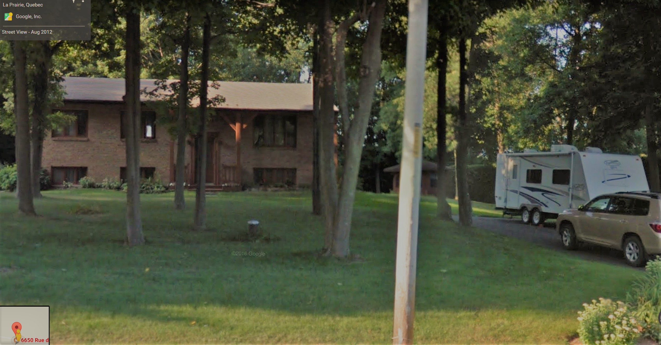

Slide 30
More Red Flags or What makes a Professional Association?
Do they have an office – Not just a PO Box or email address?
Do they have a Website?
Is the office staffed?
Is Membership Open, or is it closed or primarily available only to alumni of the teaching school?
Is the Membership Roster transparent on the website?

Slide 31
In Summary
Recommendations:
Always check that the Healthcare providers are affiliated with an alliance or National Group.
Review, and investigate the providers education, does it meet the standards of a health care professional?
Are you able to have transparent and bona fide access to the Association quality assurance?
Work together it is imperative that the Benefit providers and the Professional have the ability to work together to provide best practice.

